Slide 1
From monolith to microservices
Reification and Reactification

Slide 2
About me
Independent consultant (London)
16 years in Software Development
5 years – mostly Web API projects and microservices
Scala, Akka, Akka-HTTP, Spark
LinkedIn: https://www.linkedin.com/in/tudorpalanga
GitHub: https://github.com/tpalanga

Slide 3
Scenario
Get Availabilities
Book Tickets
Payment
Download Ticket PDF
Ticket Booking website

Slide 4
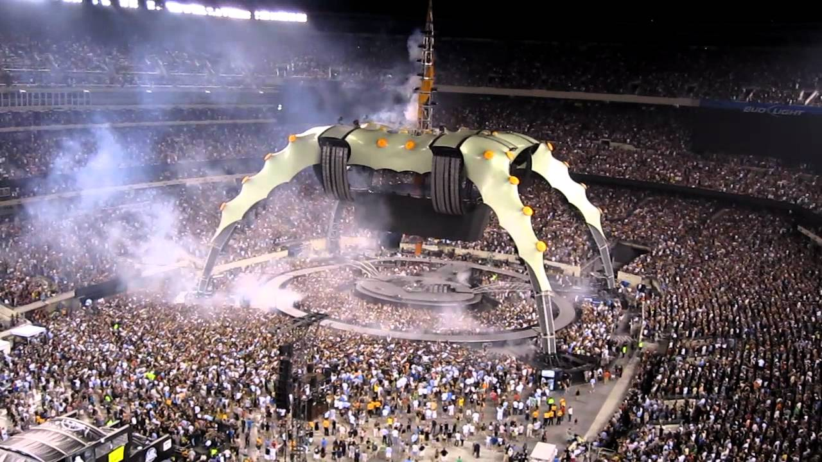
Scenario
Challenge:
- U2 tour
tickets sold out in minutes

Slide 5
Monolith
Payment Gateway
Same JVM
JVM
Availabilities
DB
Route
Book Tickets
Service
Payment
Get Tickets
Storage
Create PDF

Slide 6
Monolith
Request benchmark – 10 req / s
- Request Unmarshalling
- Create print ticket – 50%
- Response Marshalling
- Payment gateway
- DB: save ticket data
- DB: get tickets

Slide 7
Monolith
Request benchmark – 100 req / s
- Request Unmarshalling
- Create print ticket – 75 %
- Payment gateway
- DB: save ticket data
- Response Marshalling
- DB: get tickets

Slide 8
Monolith
Monolith - Same JVM
Pros
Easy to implement for start
Easy to deploy
Cons
One bottleneck affects all the system
JVM must have enough resources for all components
Synchronous

Slide 9
Akka Actors
Payment Gateway
Same JVM
JVM
Availabilities
DB
Route
ask
Book Tickets
Service
Actor(s)
Payment
Get Tickets
Storage
Create PDF

Slide 10
Akka Actors
Payment Gateway
Multi JVM – Akka Cluster
Akka Cluster
Availabilities
DB
Route
ask
Book Tickets
Service
Actor(s)
Payment
Storage
Get Tickets
Create PDF

Slide 11
Akka Actors
Multi JVM – Akka Cluster
Pros
Scale easier (add nodes)
Actors can be sharded by type to specialized nodes
Programs are represented by data
Cons
Ask pattern / ask timeouts
Synchronous

Slide 12
REST Microservices
Payment Gateway
Storage
DB
Frontend Service
Availabilities
Route
Book Tickets
Backend Service
Service
Actor(s)
Payment
Route
Service
REST API
Get Tickets
Create PDF
Create PDF

Slide 13
REST Microservices
Pros
Granular scaling on each microservice
Cons
Synchronous – roundtrip affects response time
Extra boilerplate to maintain – Backend Route / API contract

Slide 14
Reactive Microservice
Payment Gateway
DB
Storage
Frontend Service
Availabilities
Kafka
Route
Book Tickets
Service
Actor(s)
Payment
Reactive Service
Get Tickets
Service
Create PDF
Create PDF

Slide 15
Reactive Microservice
Pros
Granular scaling on each microservice
Asynchronous
Programs are represented by data
Kafka acts like a shock absorber
No need for API contract boilerplate
Cons
Extra system (Kafka) - setup, deploy

Slide 16
Conclusions
Programs as data – can play/process later (async)
Kafka can absorb peak loads
Start small (monolith) but be prepared to refactor and extract

Slide 17
Questions?
Code available on Github
https://github.com/tpalanga/reactification

